Slide 2
Introduction into the Performance Transparency Project (PTP)
09/06/2017
Notes:
The Performance Transparency Project (PTP) aims to demonstrate to robustness of the iSpin Spinner anemometer transfer function when it comes to different terrain and inflow conditions. PTP is one of the largest and most systematic demonstration projects for a wind measurement system so far.
iSpin systems will be installed on a total of around 90 wind turbines in 9 different wind farms. 3 different turbine types - each of them installed at 3 different terrain classes like flat, semi-complex, complex or offshore - will be evaluated. At each of the wind farms one met mast or lidar system will be used for a time period of at least 12 months to evaluate the nacelle transfer function stability and the power performance measurement capabilities over time. What is unique about the PTP is that the data evaluation will be made together with DTU as our project partner and 3 renown 3rd party consultants. Reports and data analysis will be made freely available to the wind industry from ROMO Wind for downloading.

Slide 3
Performance Transparency Project (PTP)
Objective:
Evaluate and demonstrate iSpin NTF robustness on the largest possible scale
Demonstrate iSpin’s ability to compare and monitor power curves regardless of terrain and wake effects
Approach:
Installation of iSpin systems on a total of around 90 wind turbines in 9 different wind farms.
3 different turbine types - each of them installed at 3 different terrain classes (flat, semi-complex and complex or offshore) - shall be evaluated.
Measurement duration at least 12 months to cover full year season
Measure power curves on turbines of the same type in different terrains classes and in accordance with IEC standard
Results to be evaluated by 3 independent and renown wind energy consultants + DTU as project partner
Full transparency: Data and reports will be made public so the wind industry can scrutinize the results
Timeline: Start installations in beginning Q3 2017 with project completion in Q2 2019
Funding: Supported by EUDP (Danish energy innovation program)

Slide 4









Project partner, Participants, 3rd Party Consultants
- Further Entities to be named soon

Slide 5
Work Packages
Fleet Performance Monitoring,
Wind park power curve,
Dynamic wind park control, etc.
Enhanced applications
Data validation
Data validation by 3rd party wind experts
iSpin PC measurement uncertainties
“Best practice” using iSpin for PC verification
6
7
8
Data provision
Calibration factors &
NTF/NPC for semi-complex / complex sites
Calibration factors &
NTF/NPC for flat sites
Calibration factors &
NTF/NPC for offshore sites
5
3
4
Execution &
Analysis
Preparation
2
Data base and WEB access
Turbine types/sites, data access and validation
3rd party wind expert selection
1

Slide 6
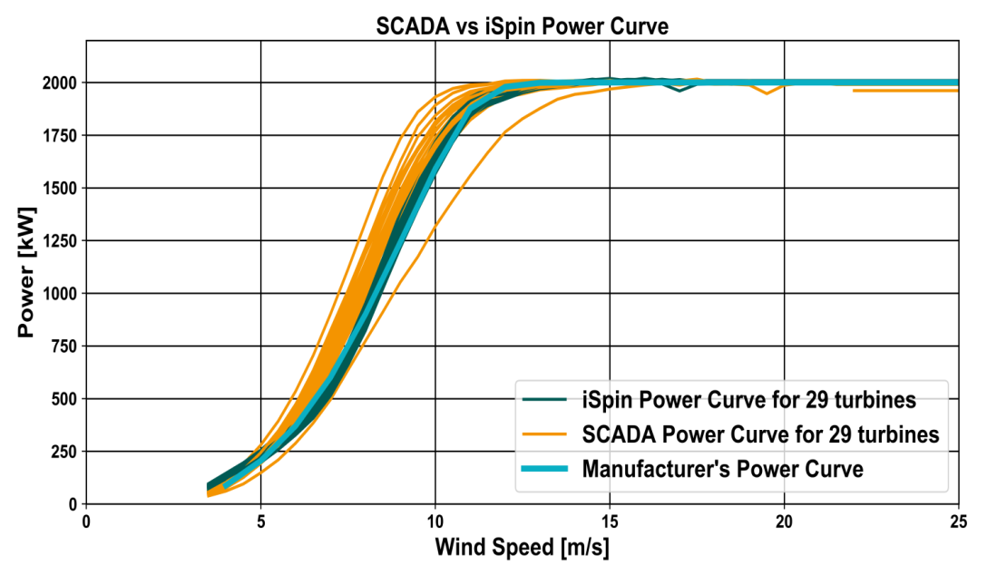
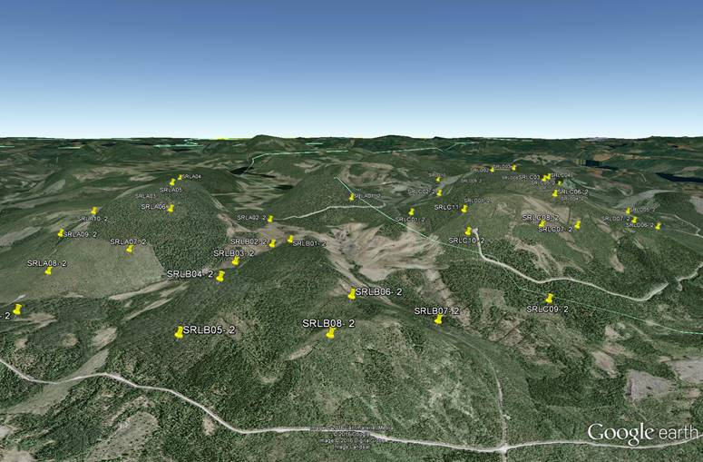
Using iSpin NTF robustness to compare Power Curves
Semi-complex Terrain Case Study
iSpin NTF created at flat terrain site in Southern-Europe
29 2MW in semi-complex terrain in Northern-Europe
360° power curves
1 year of data
Comparison iSpin / SCADA power curves
Notes:
In the following slides a case study showing the potential of the robust iSpin NTF for iSpin Guardian shall be presented:
Semi complex terrain in forested area

Slide 7
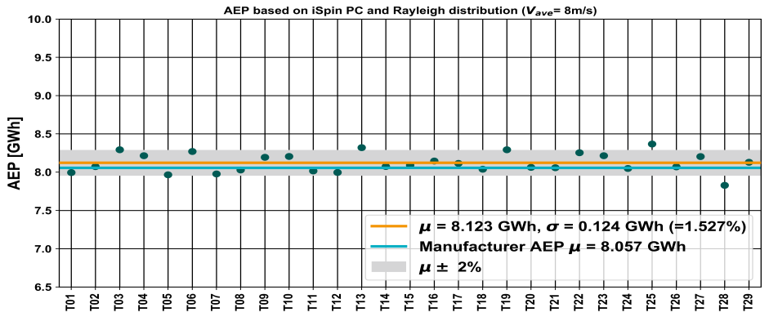
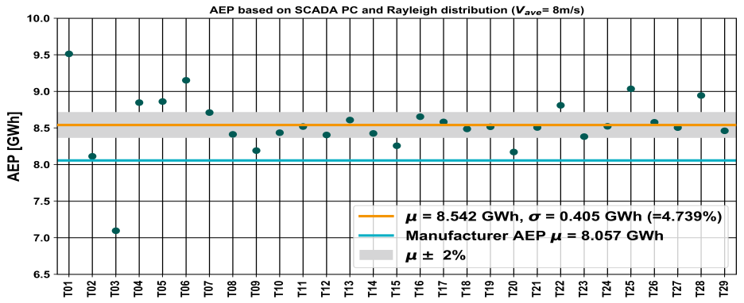
iSpin vs SCADA AEP –
Semi-complex Terrain
Out of 29 turbines performing at rated power
  2 turbines slightly over perform ±2% AEP band
  2 turbines slightly under perform ±2% AEP band
iSpin
Out of 29 turbines performing at rated power
  7 turbines over perform ±2% AEP band
  5 turbines under perform ±2% AEP band
SCADA
Notes:
For the evaluation of the AEP values the same procedure as for simple terrain example was applied,
i.e. the graphs show the resulting AEP values using the calculated power curves and a wind Rayleigh wind speed distribution for an annual average wind speed of 7m/s. The grey band covers the variation of +/-2% around the average value of all observed turbines.
iSpin based evaluation:
AEPs (power curves) very closed to each other
SCADA data based evaluation:
Beside significantly higher variation, the individual and the average AEP is in general higher than the AEPs based on iSpin measurements. Again the interpretation of performance behavior using SCADA data is very difficult. Looking e.g. only on the nacelle anemometer power curves might conclude that these turbines are on the one hand underperforming and might start to invest in optimization measures, where none are necessary (see turbines SRL_C07 and SRL_A07). On the other hand turbines which do have a real performance issue cannot get identified and will therefore not be improved (see turbines SRL_D07 and SRL_A10).

Slide 8
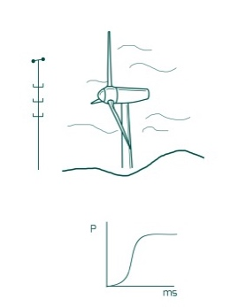
Process Flow for PTP Sites
iTF
360°
P(v_MM)
P(v_MM)
vs
P(v_iS)
P(v_iS)
vs
P(v_iS)
PC Verification using met-mast according IEC 61400-12-1
Turbine type and site specific free flow calibration factor and iSpin Transfer Function
PC Verification using iSpin according IEC61400-12-2
Create 360° iSpin based PC and compare with PC verification results
Turbine type free flow calibration factor and iSpin Transfer Function
At reference turbine
360°
360°
360°
360°
AEP_{iG} (±x%)
AEP₁
AEP₂
AEP₃
...
AEP_{n}
360°
P_iG(v_iS)
At complete wind farm
At different wind farms

Slide 9
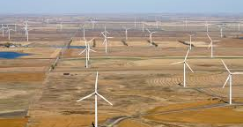
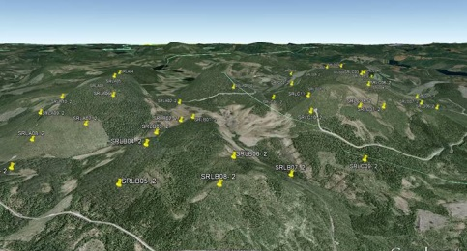
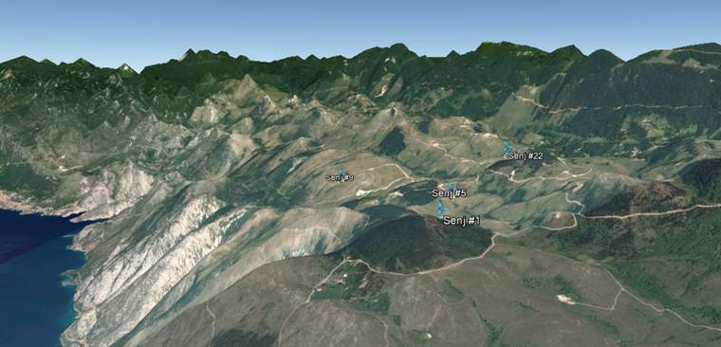
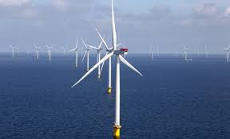
Wind farm nomination –
Targeted terrain types
Flat terrain
Semi complex terrain
Complex terrain
Offshore
Total 3 sites
(3 sites identified)
Total 2 sites
(2 site identified)
Total 3 sites
(3 sites identified)
Total 1 site
(1 site identified)

Slide 10
PTP wind turbine types, sites and assigned 3rd party consultants
Turbine type | P_{rated}[MW] | Country | Terrain | 3rd party assigned for evaluation
Enercon E82-E2 | 2.3 | Poland | Flat | Deutsche WindGuard
Enercon E82-E2 | 2.3 | Portugal | Semi-complex | Deutsche WindGuard
Enercon E82-E2 | 2.3 | Portugal | Complex | Deutsche WindGuard
Vestas V112 | 3.075 | Romania | Flat | DNV-GL
Vestas V112 | 3.075 | Croatia | Complex | DNV-GL
Vestas V112 | 3.075 | Belgium | Offshore | DNV-GL
Gamesa G90 | 2.0 | USA | Flat | DEWI/UL
Gamesa G90 | 2.0 | USA | Semi-complex | DEWI/UL
Gamesa G90 | 2.0 | USA | complex | DEWI/UL

Slide 11
Requirements to be fulfilled for PTP Sites
Site must have IEC compliant met mast (or met mast which can be made IEC compliant)
Installation of iSpin on the relevant turbines must take place within the strict time-table of the project
Participants must provide time synchronised SCADA data from the relevant turbines and met mast data and get the approval from the OEM / service company to install iSpin in the spinner and the compass on the nacelle roof
Anonymized data, reports and data analysis to be made publically available to the wind industry.
Participation in the project will be made publically known (project reports, press releases and on the PTP website).
Participants support with adequate human resources dedicated to the project at their own cost
iSpin will remain installed and ROMO Wind will keep collecting all data from the site also after project completion. The data will be used in references, product development and improvement. The data will be kept secure and anonymized.

Slide 12
Dr.-Ing. Harald Hohlen
hho@romowind.com

Slide 14
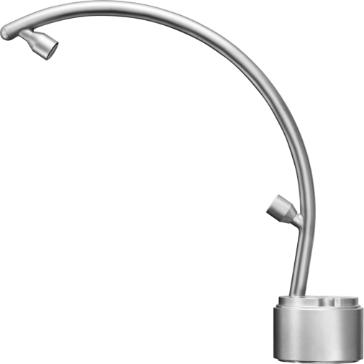
iSpin Technology – Key facts
Invented and developed by DTU / RISØ in Denmark since 2004
Innovative application of “old” proven ultrasonic measurement technology
Since April 2013: IEC 61400-12-2 standard for performance measurement
Acquired and industrially developed by ROMO Wind since 2011
Measurement and derived quantities:
  Wind speed (rotor speed and “free” wind)
  Yaw misalignment
  Flow inclination angle
  Air temperature and air pressure
  Nacelle direction
  Wind direction
  Turbulence intensity

Slide 15
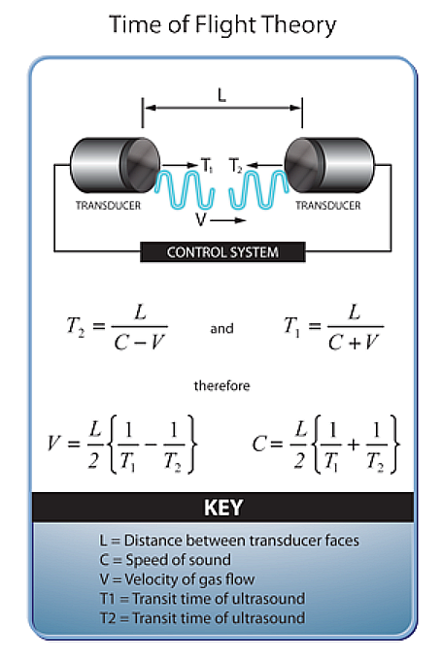

iSpin Technology – Key facts
Ultrasonic measurement principle
Well-known basic technology
Used for wind measurements
in the atmosphere for more than
40 years
Robust technology – longterm measurements
High frequency measurements possible
3D measurement (is also available
in 2D and 1D)
Flow over spinner
Sensor path
Spinner

Slide 16

iSpin Technology – Measurement principle
V₁, V₂, V₃ , Φ
U_{hor}, γ, β, Φ
Rotor azimut
Position of the iSpin Spinner- Anemometers
V₁, Φ₁
120°
120°
V₃, Φ₃
120°
V₂, Φ₂
Position of conventional nacelle anemometry
Front view
v_{1,2,3} = 1D wind speed signal
φ_{1,2,3} = accelerometer signal

